Slide 1
Roy Geddes Head of Unit FSB TCB

Slide 2
Agenda
Roy Geddes
One Commission Update
Entity Supervision 2017
Questions

Slide 3
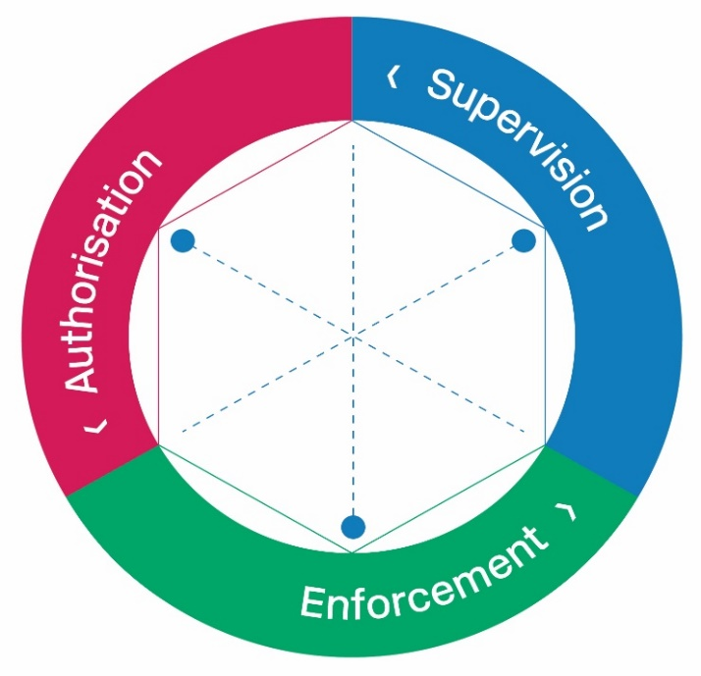
JFSC – the core functions
Policy
Financial Crime Policy
Registry
Supervision Teams
Banking
FSB & TCB
IB, FSB & Insurance
TCB & DNFBP
Supervisory Examinations Unit (SEU)
Central Support Unit (CSU)
Risk Unit
Operations
ICT | PMO Information Management | Communications | HR | Finance | Facilities

Slide 4
The Supervision Units

Slide 5
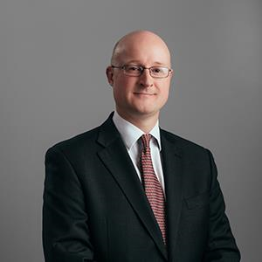
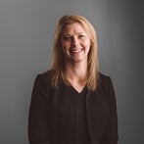
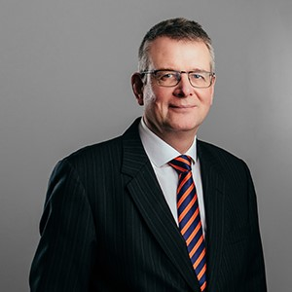
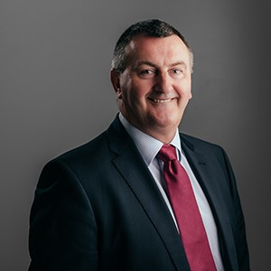
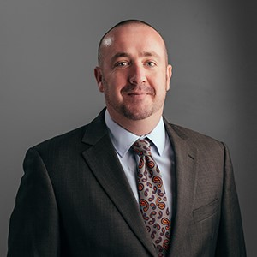
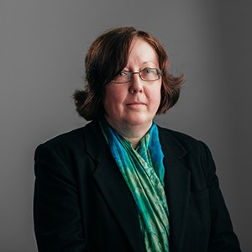
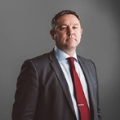
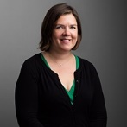
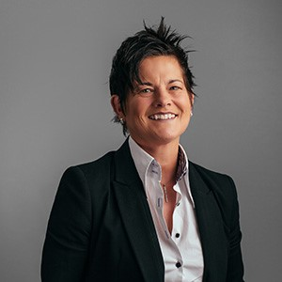
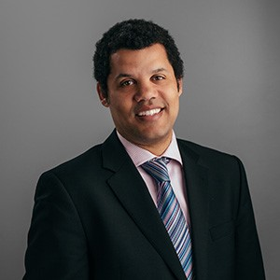
John Everett
Deputy Director General
Jill Britton
Director of Supervision
Mark Sumner
Director of Supervision and Risk
Roy Geddes
Head of FSB & TCB
Tony Shiplee
Head of IB, Insurance & FSB
Anita Matthews
Head of TCB & DNFBP
Andrew Garbutt
Head of Supervisory Risk
Andrea John
Head of Banking
Sam Davison
Head of SEU
Francis Katamba
Head of CSU

Slide 6
Supervision Lifecycle
SRU
Authorisation
Supervision Teams
SEU
CSU

Slide 7
Supervision - Enhanced
Enhanced
Strategic Supervisory plan - business risk assessment driven
Risk Assessment Meetings – inquisitive approach, comply or explain
Off-site – Supervisor lead
Data collection, risk model, surveys, desk based reviews
On-site – SEU lead
Examination types; Entity, Themed, Risk Event

Slide 8
Supervision - Proactive
Proactive
Risk Assessment meetings - supervisor lead
Risk based agenda, pre-planned meetings, agreed remediation
Off-site – Supervision lead
Data collection, risk model, surveys, desk based reviews
On-site – SEU lead
Examination types; Entity, Themed, Risk Event

Slide 9
Supervision - Reactive
Reactive
Outreach initiatives
Off-site
Review of directors declarations and annual returns. Requirement to report material events and comply with Code of Practice.
On-site
Themed Survey or Risk Event

Slide 10
Categories of Entities – ratings summary
Enhanced – Strategic supervisory plan for each entity
Proactive – Risk Assessment programme for each entity
Reactive – Self reporting and reliance on annual declarations
Supervisory Approach
Enhanced/Pro-Active | 290
Reactive | 1,002
Total | 1,292

Slide 11
Anita Matthews Head of TCB & DNFBP Roy Geddes Head of FSB & TCB

